Slide 1
SODC Local Plan 2032 Consultation
Thame Town Council
PUBLIC MEETING
SOUTH OXFORDSHIRE DISTRICT COUNCIL
LOCAL PLAN 2032 -
PREFFERED OPTIONS CONSULTATION
Thursday 4th August 2016 7.30pm
St Mary’s Church Thame
Why are we here?

Slide 2
SODC Local Plan 2032 Consultation
Why are we here?
South East Plan
Core Strategy & Local Plan
Neighbourhood Plan
New Government rules
SHMA (figures disputed by Local Councils)
Local Plan Expert Group
Planning appeals being allowed (ie Chinnor & Benson)
5 year land supply
Local Councils are having to produce new plans
More houses for Thame

Slide 3
SODC Local Plan 2032 Consultation
The SODC Plan 2032
Relevance to Thame
What do you think?
How to respond to the Plan
Your opinions

Slide 4
SODC Local Plan 2032 Consultation

Slide 5
SODC Local Plan 2032 Consultation
Third in a series of consultations since 2014
Need to build 15,750 homes in SODC up to 2032

Slide 6
SODC Local Plan 2032 Consultation

Slide 7
SODC Local Plan 2032 Consultation

Slide 8
SODC Local Plan 2032 Consultation

Slide 9
SODC Local Plan 2032 Consultation

Slide 10
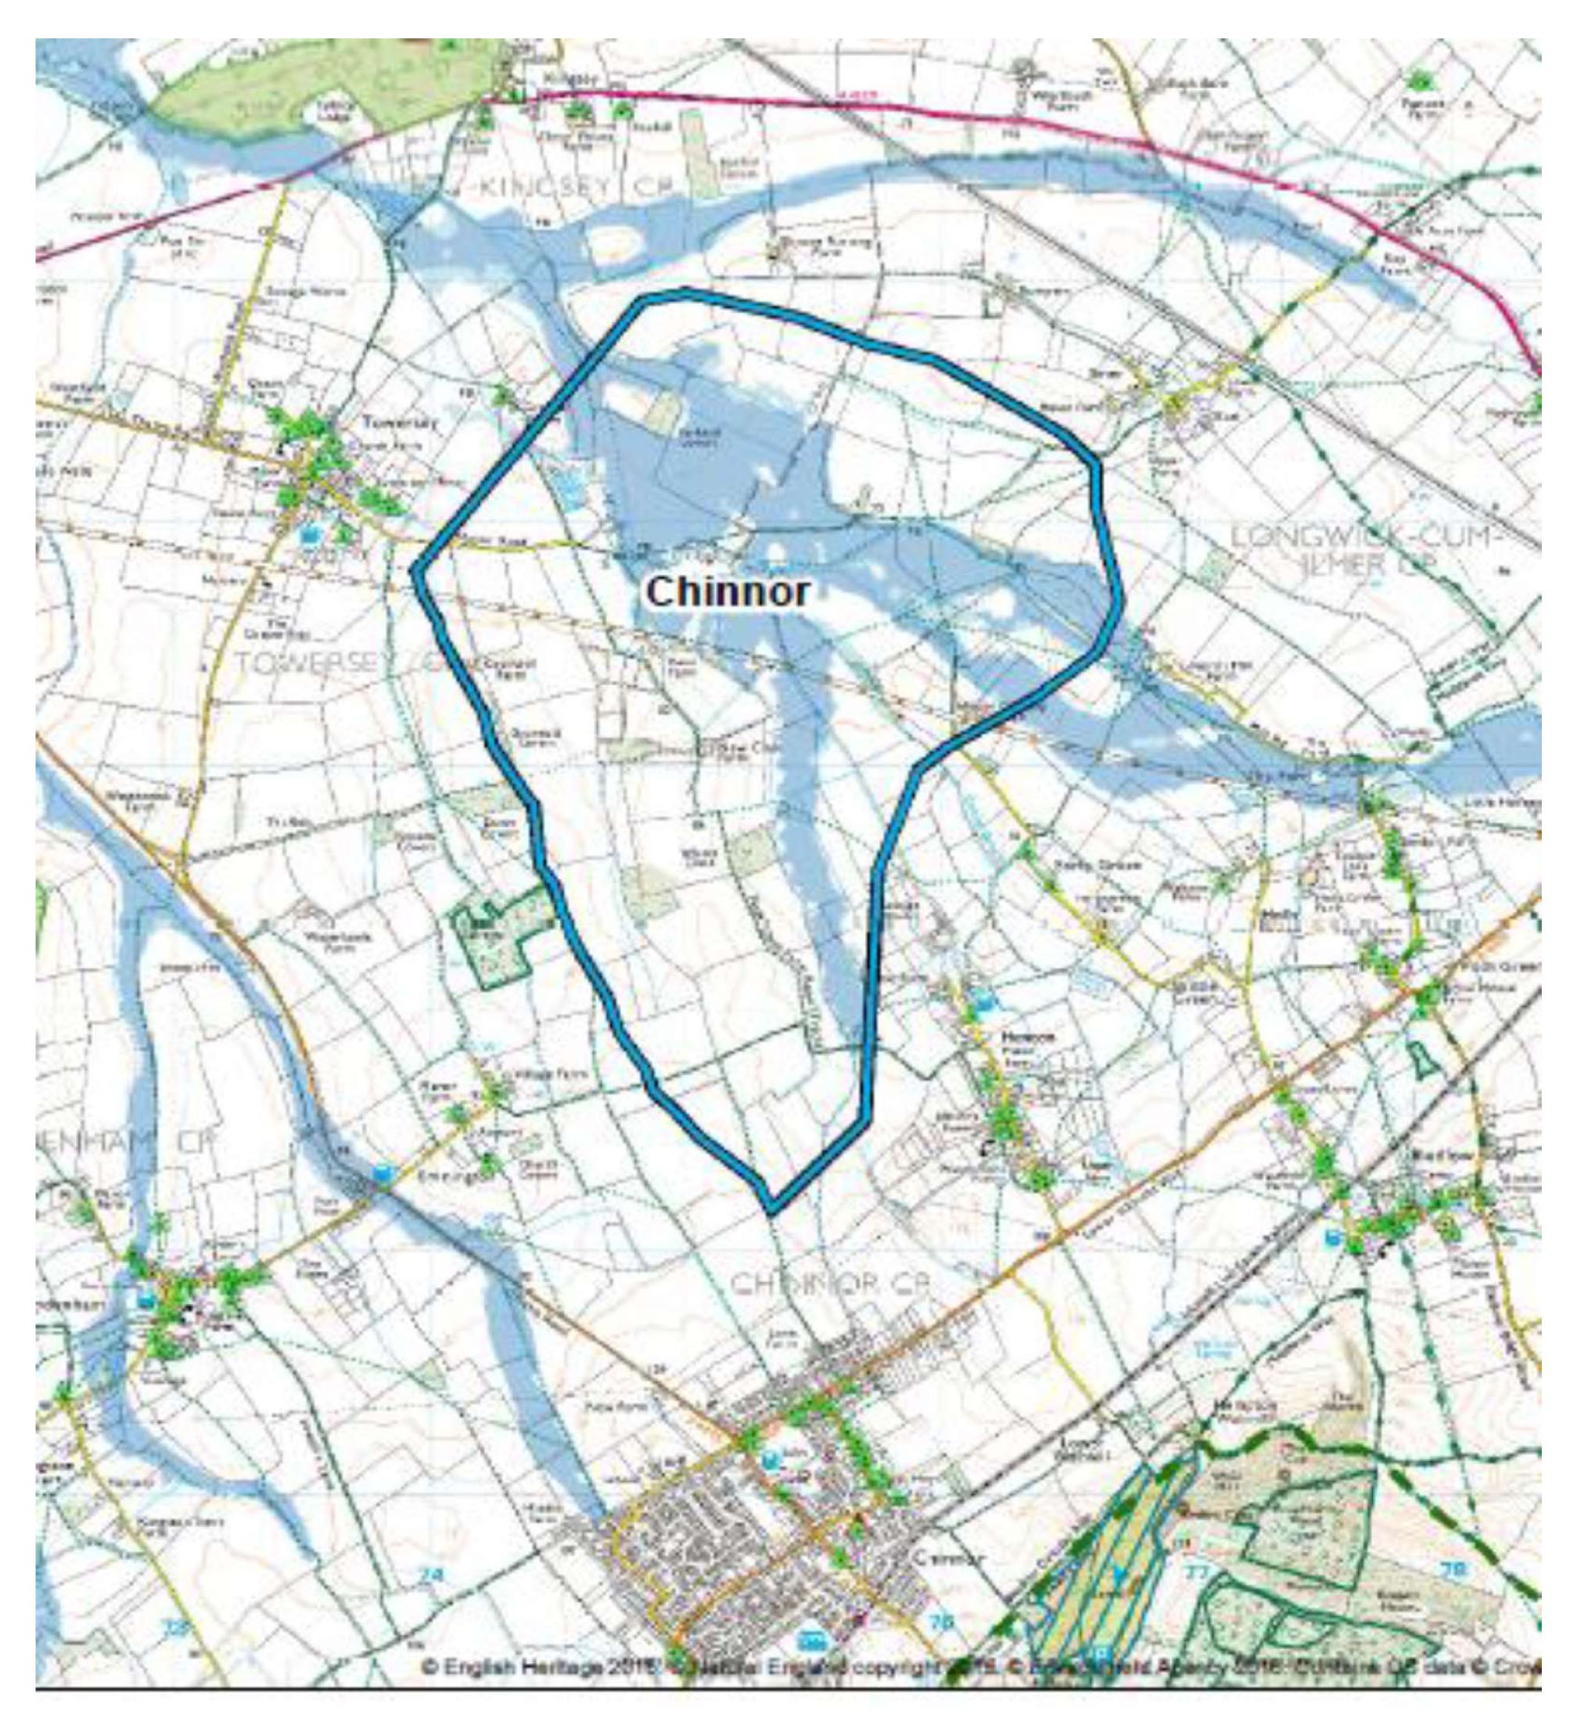
SODC Local Plan 2032 Consultation

Slide 11
SODC Local Plan 2032 Consultation

Slide 12
SODC Local Plan 2032 Consultation

Slide 13
SODC Local Plan 2032 Consultation

Slide 14
SODC Local Plan 2032 Consultation

Slide 15
SODC Local Plan 2032 Consultation

Slide 16
SODC Local Plan 2032 Consultation

Slide 17
SODC Local Plan 2032 Consultation

Slide 18
SODC Local Plan 2032 Consultation

Slide 19
SODC Local Plan 2032 Consultation

Slide 20
SODC Local Plan 2032 Consultation

Slide 21
SODC Local Plan 2032 Consultation

Slide 22
SODC Local Plan 2032 Consultation

Slide 23
SODC Local Plan 2032 Consultation

Slide 24
SODC Local Plan 2032 Consultation

Slide 25
SODC Local Plan 2032 Consultation
Local Plan 2032
Relevance to Thame
What do you think?
How to respond to the Plan
Your opinions

Slide 26
SODC Local Plan 2032 Consultation
Thame Growth
 | Housing Units | Population
2011 Base | 4,875 | 11,561
2011 Commitments | 162 | 405
Neighbourhood Plan | 775 | 1,938
Windfalls | 233 | 522
New Allocations | 600 | 1,500
 | 6,645 | 15,926
Percentage Increase | 36% | 38%

Slide 27
SODC Local Plan 2032 Consultation
Towns Growth Comparison - Housing Units
 | Thame | Wallingford | Henley
2011 Base Line | 4875 | 3432 | 5678
Core strategy sites B/F | 162 | 36 | 158
Adverse Planning appeals | 0 | 84 | 0
Windfalls | 233 | 175 | 59
Core Strategy 2027 | 775 | 555 | 330
2032 New Allocations | 600 | 430 | 0
Totals | 6645 | 4712 | 6225
Growth % | 36% | 37% | 10%

Slide 28
SODC Local Plan 2032 Consultation
Housing Units Comparison
 | Thame | Walling'd | Henley | Larger Villages | Other Villages | Total
2011 base line | 4875 | 3432 | 5678 | 15753 | 15248 | 44986
Core strategy sites B/F | 162 | 36 | 158 | 805 | 0 | 1161
Adverse Planning appeals | 0 | 84 | 0 | 448 | 0 | 532
Windfalls | 233 | 175 | 59 | 175 | 469 | 1111
Core Strategy 2027 | 775 | 555 | 330 | 1114 | 0 | 2774
2032 Allocation | 600 | 430 | 0 | 1759 | 786 | 3575
Total | 6645 | 4712 | 6225 | 20054 | 16503 | 54139
Growth % | 36% | 37% | 10% | 27% | 8% | 20%

Slide 29
SODC Local Plan 2032 Consultation

Slide 30
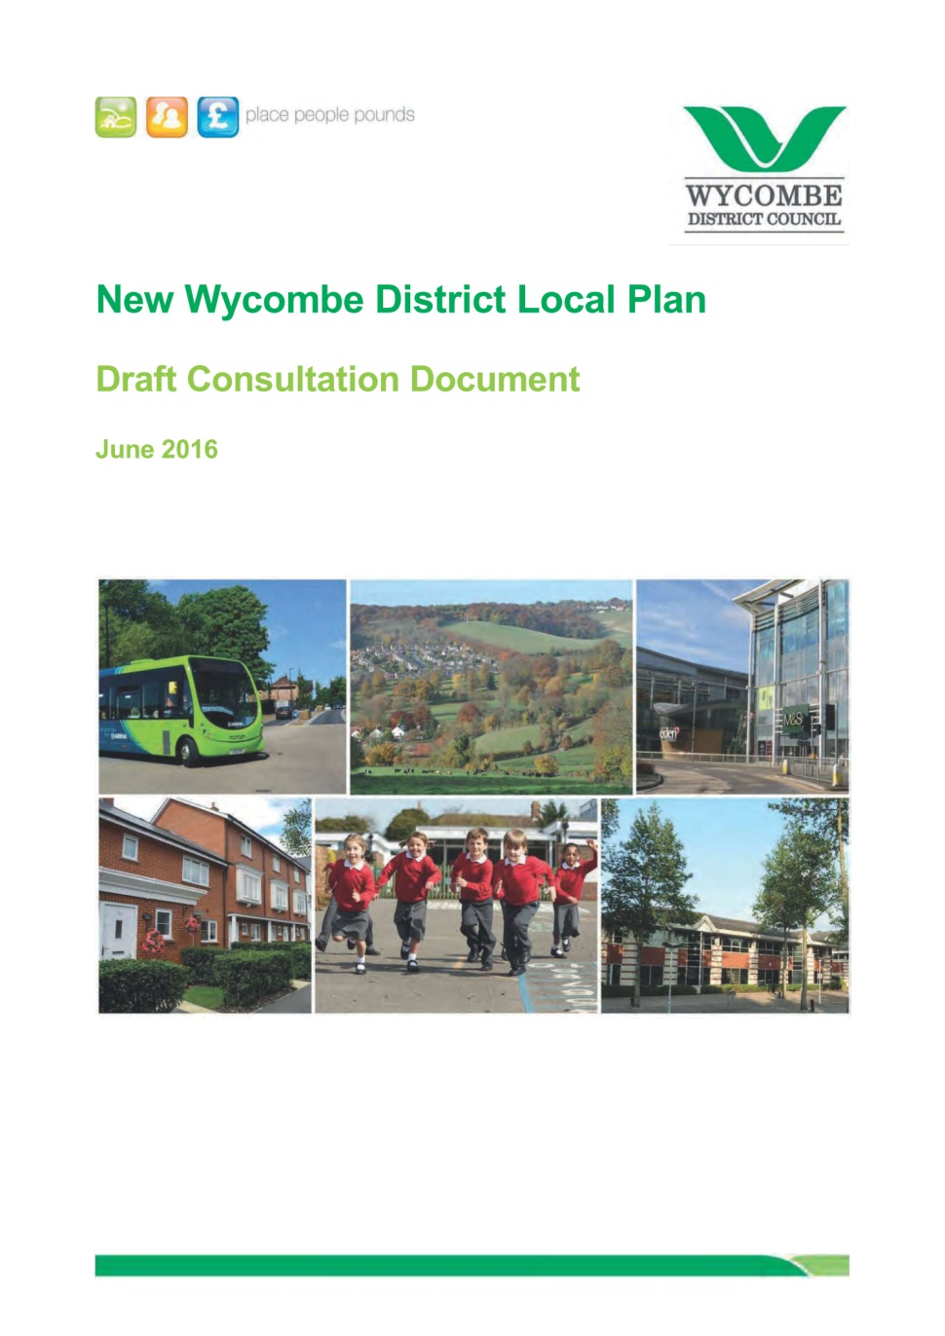
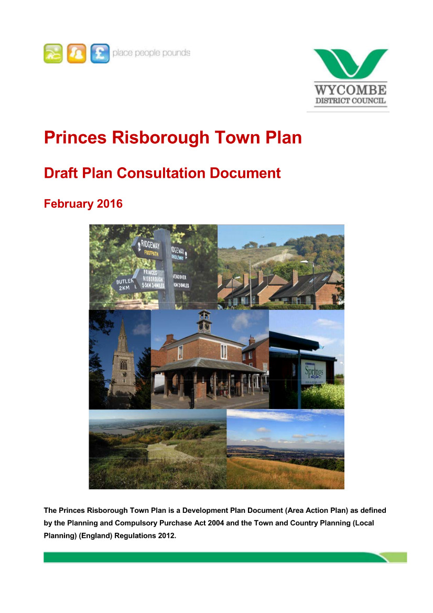
SODC Local Plan 2032 Consultation

Slide 31
SODC Local Plan 2032 Consultation

Slide 32
SODC Local Plan 2032 Consultation

Slide 33
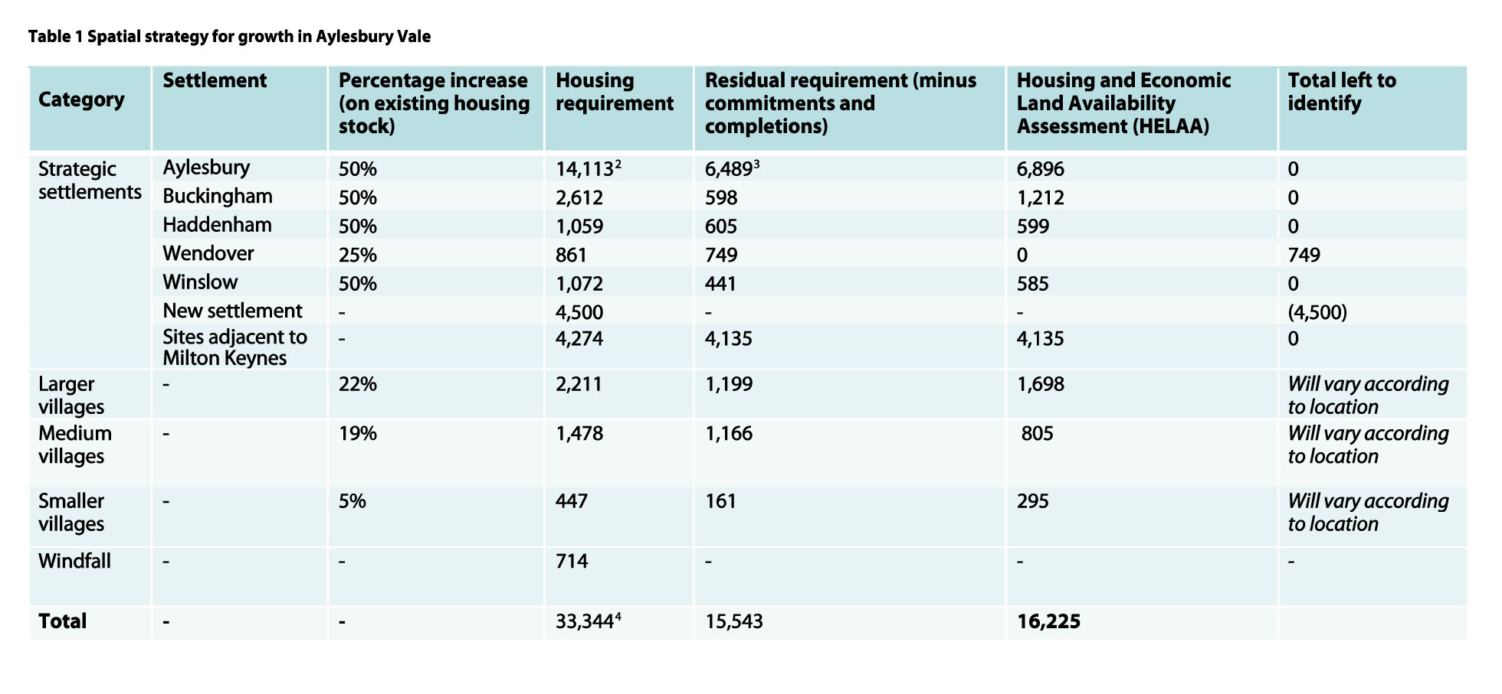
SODC Local Plan 2032 Consultation

Slide 34
SODC Local Plan 2032 Consultation

Slide 35
SODC Local Plan 2032 Consultation

Slide 36
SODC Local Plan 2032 Consultation

Slide 37
SODC Local Plan 2032 Consultation

Slide 38
SODC Local Plan 2032 Consultation
Bucks County Council.
The options fail to recognise the significance of growth centres around the Vale e.g. Thame, Bicester, Brackley Silverstone & MK.
For example the proposed growth at Thame and Princes Risborough may present opportunity for significant growth at Haddenham, perhaps as a new settlement.

Slide 39
SODC Local Plan 2032 Consultation
Local Plan 2032
Relevance to Thame
What do you think?
How to respond to the Plan
Your opinions

Slide 40
SODC Local Plan 2032 Consultation
Your chance to comment!

Slide 41
SODC Local Plan 2032 Consultation
Have your Say!

Slide 42
SODC Local Plan 2032 Consultation
Background to the Plan
Relevance to Thame
What do you think?
How to respond to the Plan
Your opinions

Slide 43
SODC Local Plan 2032 Consultation
How to Respond!

Slide 44
SODC Local Plan 2032 Consultation

Slide 45
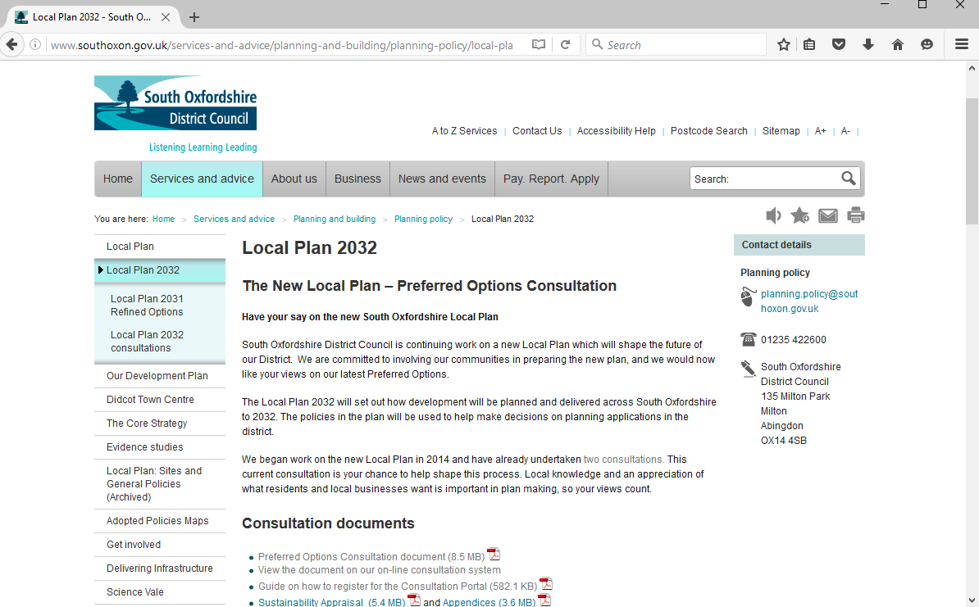
SODC Local Plan 2032 Consultation

Slide 46
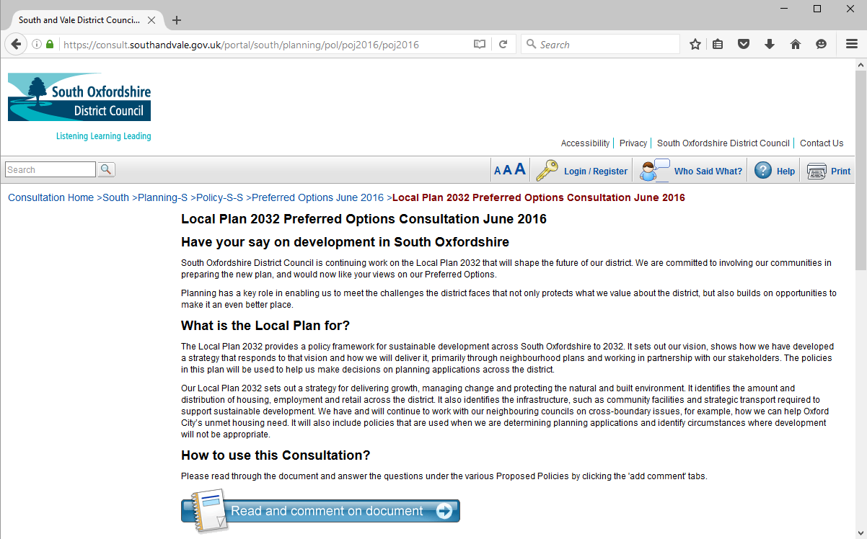
SODC Local Plan 2032 Consultation

Slide 47
SODC Local Plan 2032 Consultation
e-mail to:
planning.policy@southoxon.gov.uk
put “Local Plan” as the subject
Letter to
Planning Policy,
South Oxfordshire District Council,
135 Eastern Avenue,
Milton Park, Milton
OX14 4SB
Feel free to give your own response
and do not be constrained by the
questions asked in the Plan.

Slide 48
SODC Local Plan 2032 Consultation
Local Plan 2032
Relevance to Thame
Question and Answer
How to respond to the Plan
What do you think?
Your opinions

Slide 49
SODC Local Plan 2032 Consultation
Your opinion counts!!
South Oxfordshire District Council:
¨ 600 more homes proposed for Thame
¨ 2.5 hectares of employment land
¨ Supermarket proposal at 1500 m² plus shops
¨ New Settlement in SODC - Where? How big?
¨ Thames Water— reservoir proposal
Aylesbury Vale District Council:
¨ New Settlement in Haddenham +50% growth
Wycombe District Council:
¨ 2,500 new homes for Princes Risborough

Slide 50
SODC Local Plan 2032 Consultation
Do you Support?
600 more homes in Thame
Don’t Know
Yes
No
Your comments

Slide 51
SODC Local Plan 2032 Consultation
Background to the Plan
Relevance to Thame
Question and Answer
How to respond to the Plan
What do you think?
Your opinions

Slide 52
SODC Local Plan 2032 Consultation
Your Opinions Count!

Slide 53
SODC Local Plan 2032 Consultation
Your opinion counts!!
South Oxfordshire District Council:
¨ 600 more homes proposed for Thame
¨ 2.5 hectares of employment land
¨ Supermarket proposal at 1500 m² plus shops
¨ New Settlement in SODC - Where? How big?
¨ Thames Water— reservoir proposal
Aylesbury Vale District Council:
¨ New Settlement in Haddenham +50% growth
Wycombe District Council:
¨ 2,500 new homes for Princes Risborough

